Slide 1
Understanding Academic Writing
Ali Bazi
PhD. Candidate, Hematology and Blood Banking

Slide 2
Writing a manuscript:
What
Structure
Scientific content
How
Format
Grammar

Slide 3
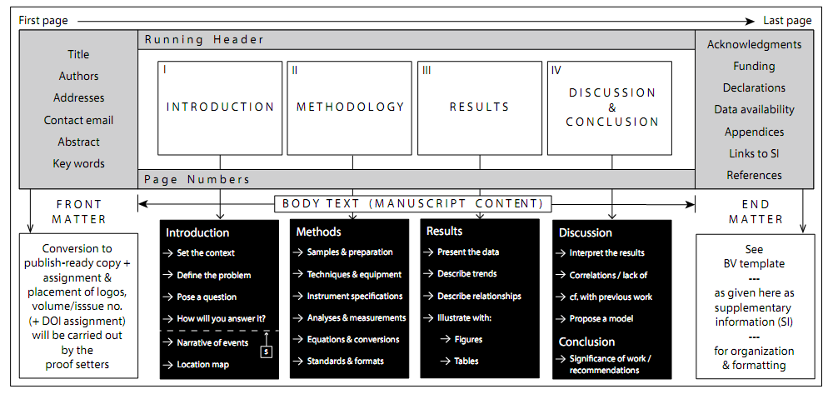

Slide 4
Issues with structure
- Poor title and/or keywords (plus, no keywords or too many keywords)
- Weak abstract
- Poor introduction (I);
- Weak or no methods (M);
R and D Mixing (R = Results; D = Discussion)
Poor or no conclusion (C);
- IMRDC is out of order

Slide 5
Title
Convey the main topics of the study
Highlight the importance of the research
Be concise
should…

Slide 6
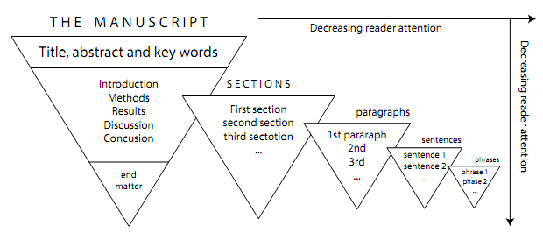
Within-section sequence matters…

Slide 7
Abstract
Background
Objectives
Methods
Results
Conclusion

Slide 8
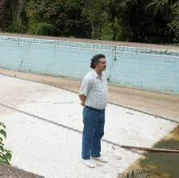
Abstract
…should be

Slide 9
Keywords
Use keywords not used in the title

Slide 10
Introduction
Background, concepts
Current Knowledge
Gaps
Hypothesis, objectives

Slide 11
Methods
Design
Population
Data Collection
Data Analysis

Slide 12
Results
Baseline
Descriptive
Analytic
Outcomes
Tables
Text
Figures

Slide 13
Avoid RD mixing
Separate objective findings (results) from their interpretation (discussion) and avoid discussion in the results

Slide 14
Discussion
Summary of key findings
Interpret key findings
Review Literature

Slide 15
Using Checklist
STROBE
CONSORT
PRISMA
MOOSE
STARD
Etc.

Slide 16
Writing a manuscript
What
Structure
Scientific content
How
Format
Grammar

Slide 17
Scientific problems
Citation
Definition
Clarification
Terminology consistently
Acronym and symbols
Units

Slide 18
Citation issues
Reference the root source of any fundamental equation, idea, definition, or concept
Add reference support to all statements that are not supported by your own data or interpretations

Slide 19
Definition issues
Defne all key terms in the introduction
Defne all technical terms
Defne terms that will likely be unfamiliar to the audience

Slide 20
Clarification issues
Support the statement with a sound argument and/or numbers
Ensure that the statement can be understood in only one way

Slide 21
Terminology issues
Use standard and correct terminologies
Keep the terminology consistent across the manuscript (including in figures and tables)

Slide 22
Acronyms, symbols, and units
Defne all uncommon acronyms at first usage
Defne all symbols as indicated
Follow the SI system units

Slide 23
Writing a manuscript
What
Structure
Scientific content
How
Format
Grammar

Slide 24
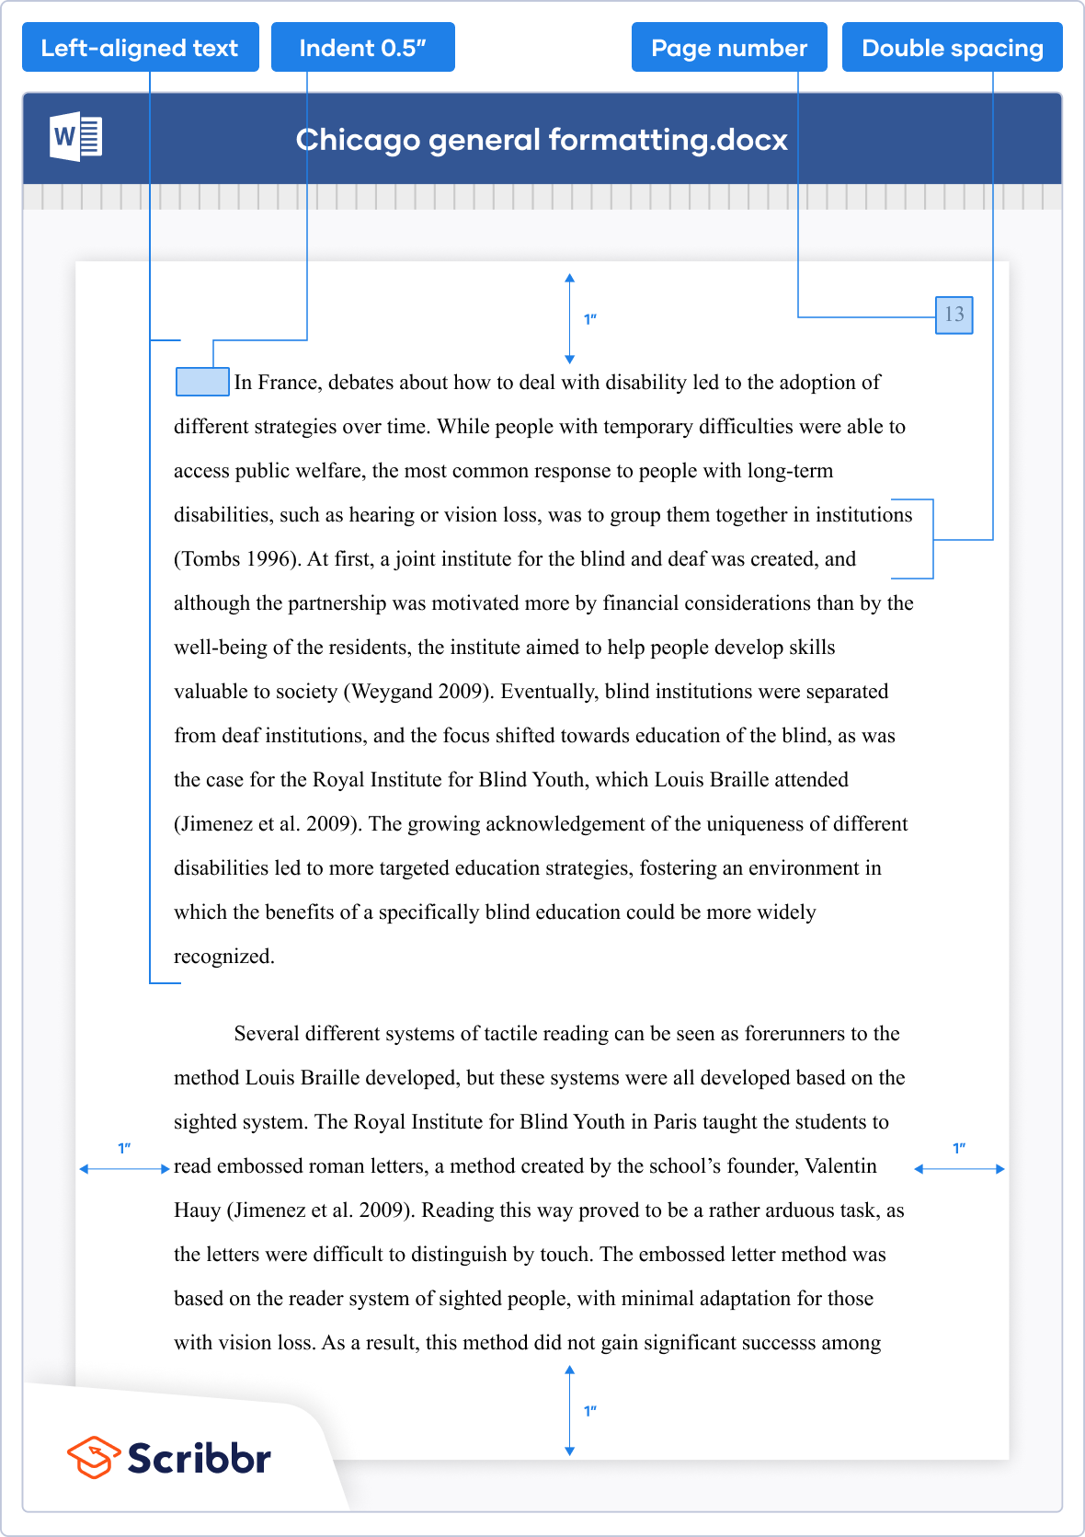
Chicago Manual of Style (2010)

Slide 25
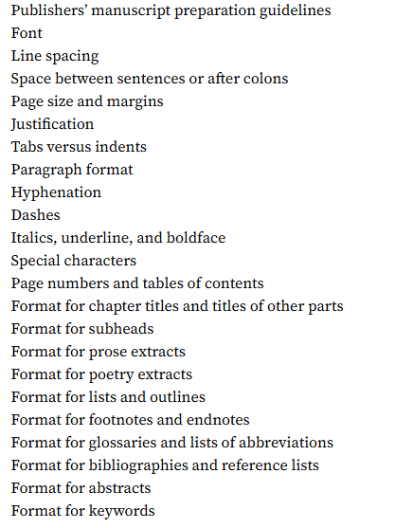
General Formatting Items

Slide 26
Writing a manuscript
What
Structure
Scientific content
How
Format
Grammar

Slide 27
Grammar
Sent. Length
Paragraphs
Tenses

Slide 28
Tenses
Do not complicate your life
Present (simple): I analyze
Past (simple): I analyzed
Future: I will analyze

Slide 29
General guide on tenses
Introduction: Past (simple) and present (simple)
“REF found that”; “Four studies revealed that”;
“We here examine”; “We propose.”
Methods: Past (simple)
“We sampled”; “We measured”; “We carried out”;
“We used”; “We made.”
Results/discussion: past/present (simple)
“We show”; “We found”; “The trend is”; “Data are”;
“This result is”; “We observe.”
Conclusion: present and future.
“We propose”; “We suggest”; “We need”; “We
will”, “We question”; “We give.”

Slide 30
Sentence length
Length
Organization
Structure

Slide 31
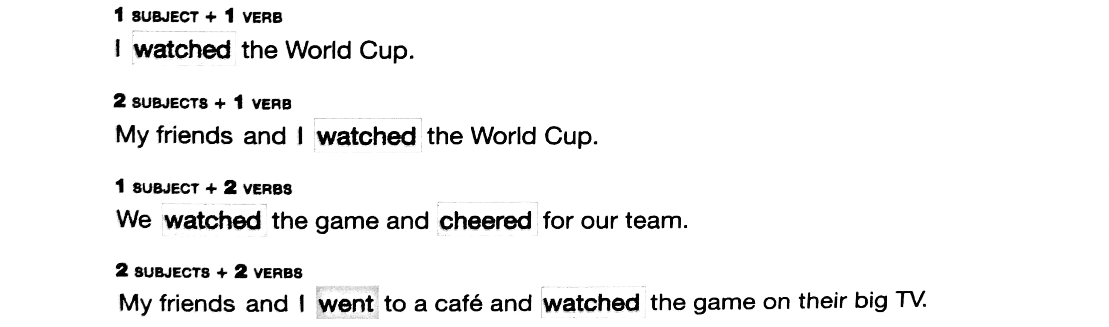
Simple Sentence Patterns
A simple sentence has one subject-verb combination.

Slide 32
Simple vs. Compound Sentence
A compound sentence has two subject-verb combinations.
A compound sentence has two connected simple sentences.
Place a “comma” after the first simple sentence, and then use a coordinating conjunction.
and
or
but
so
yet
nor

Slide 33
Complex sentences
Sentences with clauses

Slide 34
Less is the length, more is the organization

Slide 35
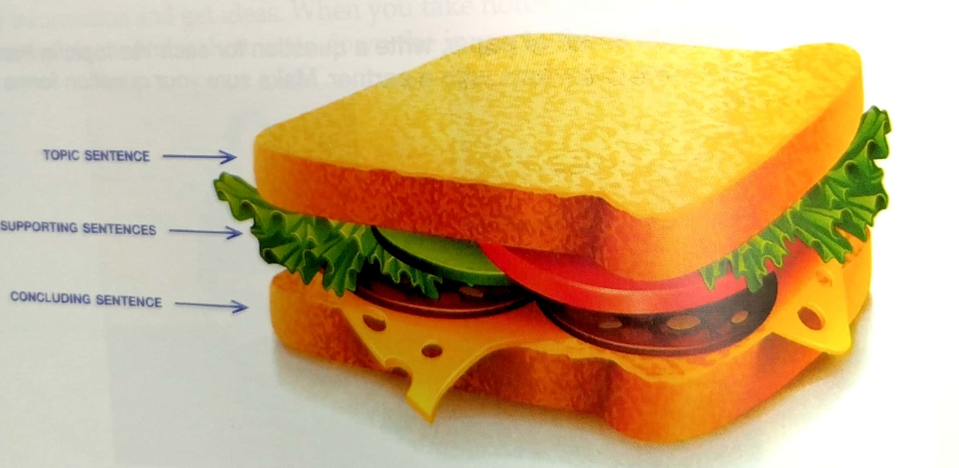
A paragraph is like a…

Slide 36
Topic sentences
A topic sentence comes at the beginning of a paragraph.
The topic sentence gives the writer’s main idea about the topic.
A good topic sentence helps readers understand the paragraph.
It has two parts:
Topic
Controlling idea
The topic should not be too general nor too specific.

Slide 37
Supporting sentences
Main points
Supporting details

Slide 38
Unity (focus) and Coherence (logic)
Supporting sentences must be relevant to the topic.
In a paragraph with unity, all supporting sentences work together to support the topic sentence and are relevant to the topic and controlling idea.

Slide 39
How to be coherent
Repeat key nouns
Use consistent pronouns
Arrange ideas in logical order
Use transition signals

Slide 40
Use of nouns/pronouns
Be CONSISTENT in using pronouns

Slide 41
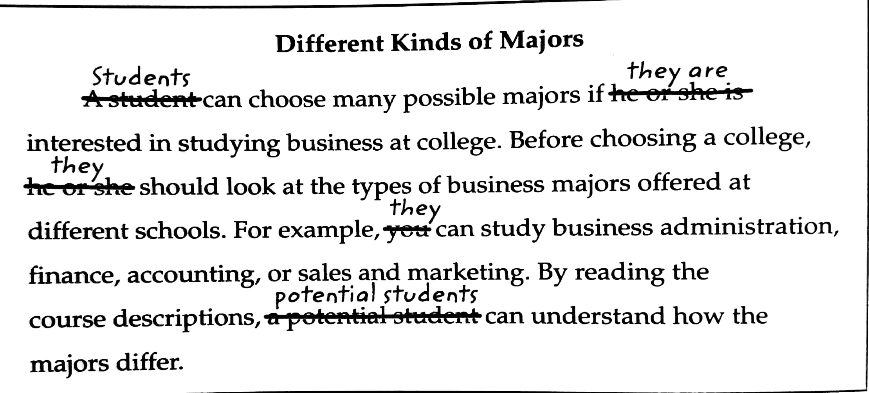

Slide 42
Logical order
Chronological order (a sequence of events/steps)
Logical division of ideas

Slide 43
Logical division of ideas
Dividing a topic into main points and discussing each point separately.
This is an important technique for organizing supporting sentences.
Example of divisions:
Reasons
Kinds/types
Styles
Disadvantages/advantages
Qualities/features
Similarities/differences

Slide 44
Transition signals
Transition signals are like traffic signals. They tell readers when to slow down, turn around, and stop.

Slide 45
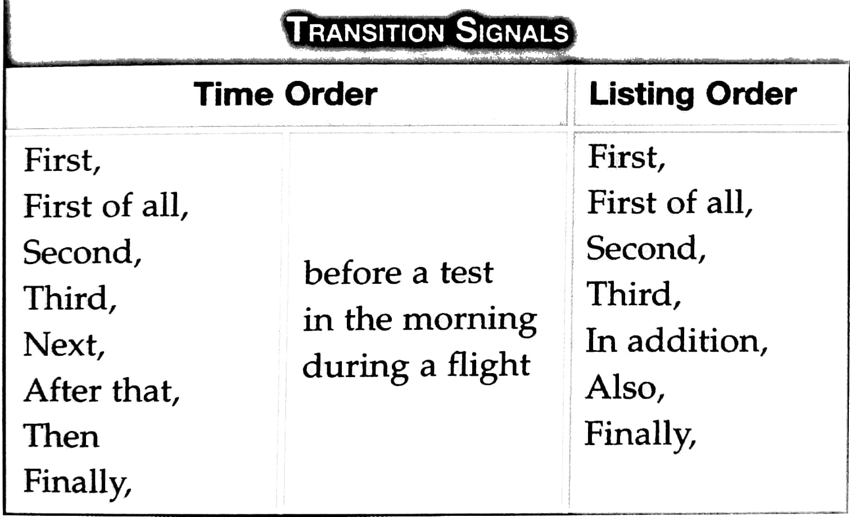
List-order and Time-order

Slide 46
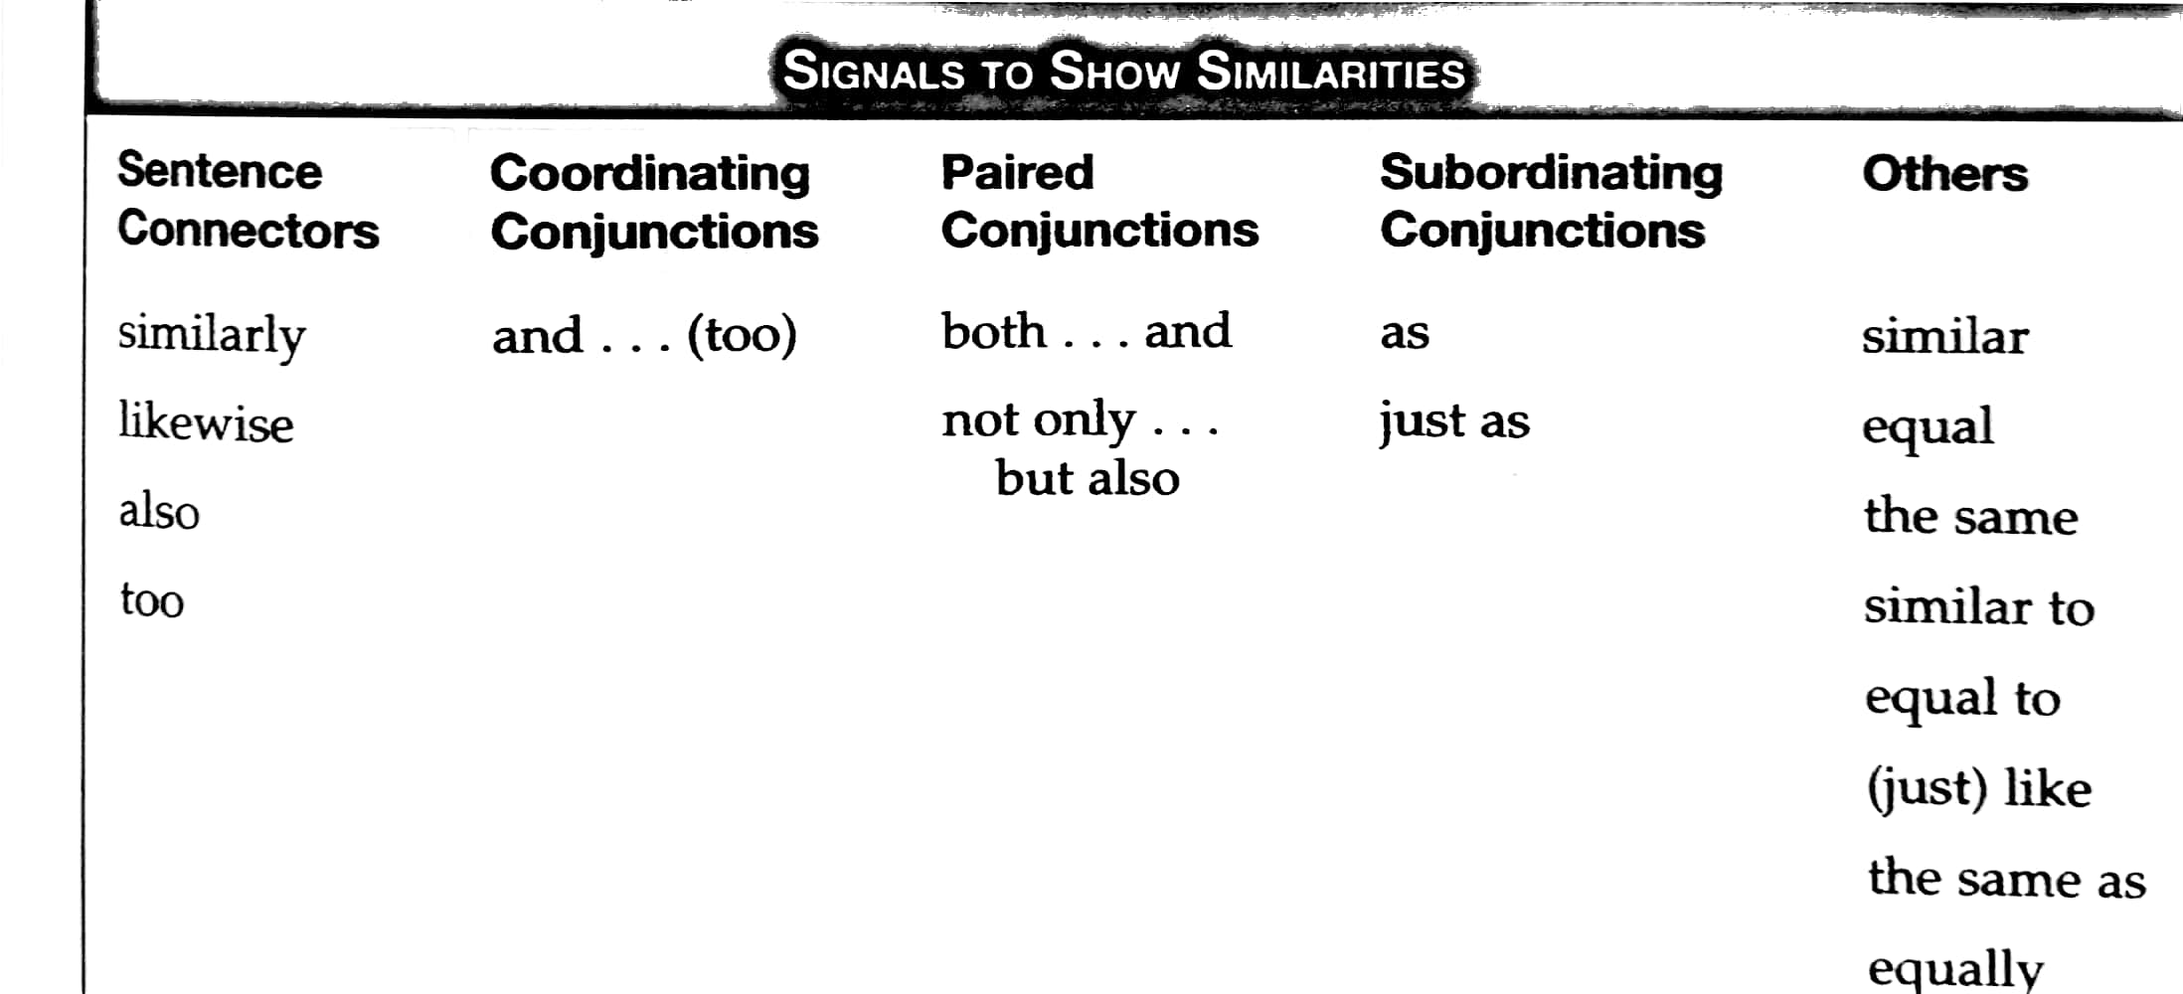
Similarity Signals

Slide 47
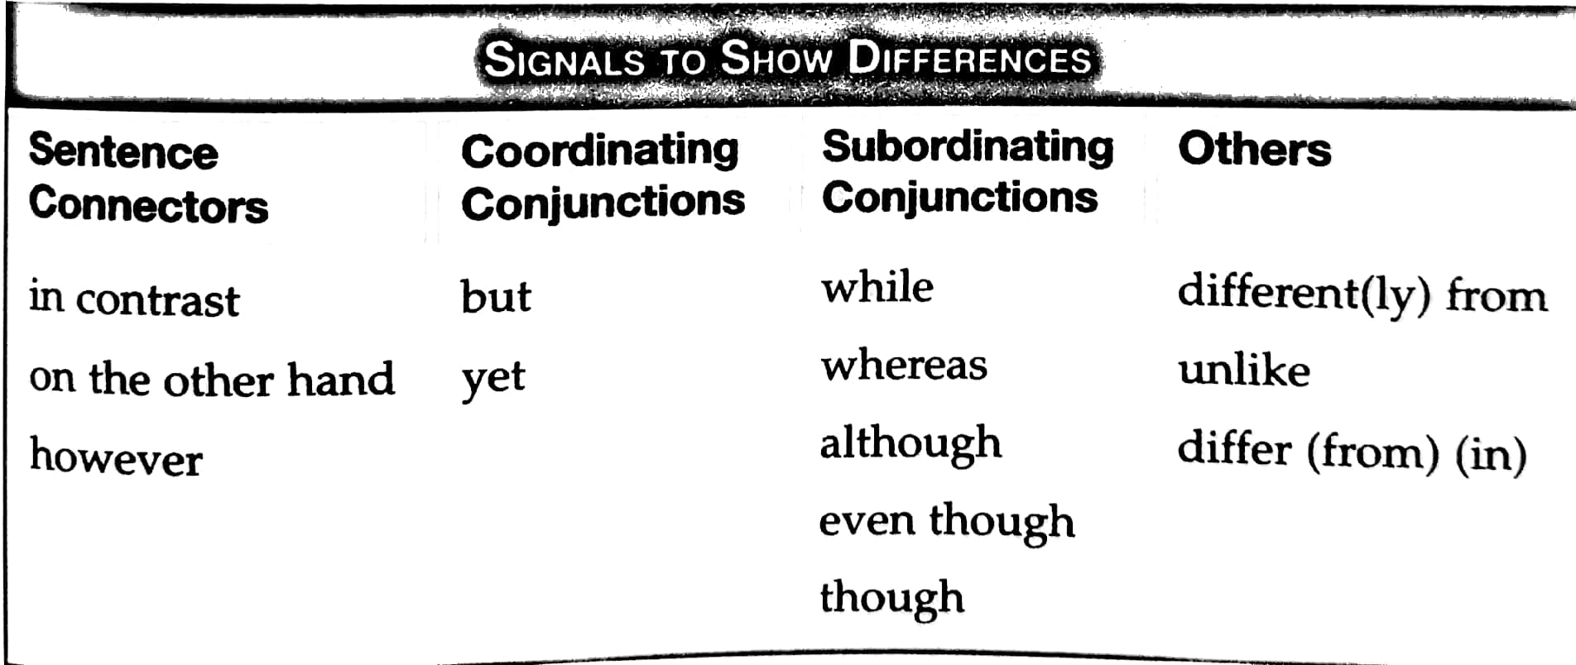
Contrast signals

Slide 48
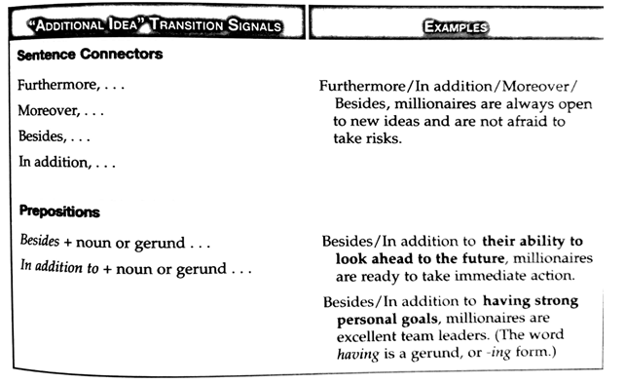
Between-Paragraph Transition

Slide 49
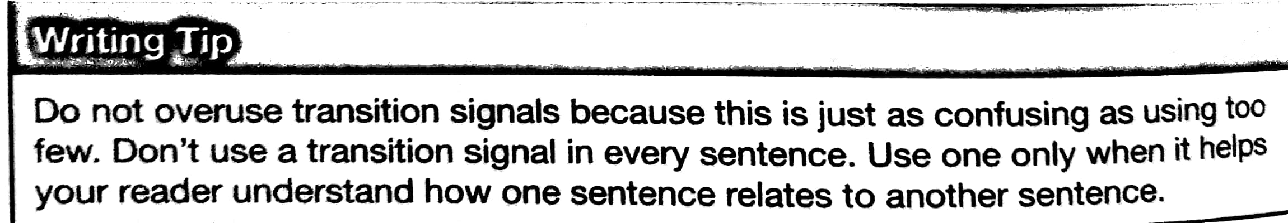
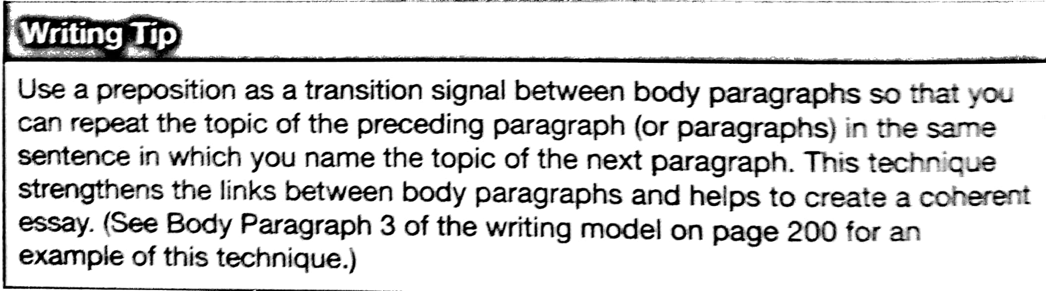

Slide 50
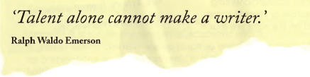
Academic writing vs. Other types of writing

Slide 51
Academic writing ..…..than other forms of writing
is more / less objective
uses more / less referencing
is more / less complex
has a more/less formal structure
Characteristics of academic writing include
A formal tone
Use of the third-person rather than first-person perspective (usually)
A clear focus on the research problem under investigation
Precise word choice.

Slide 52
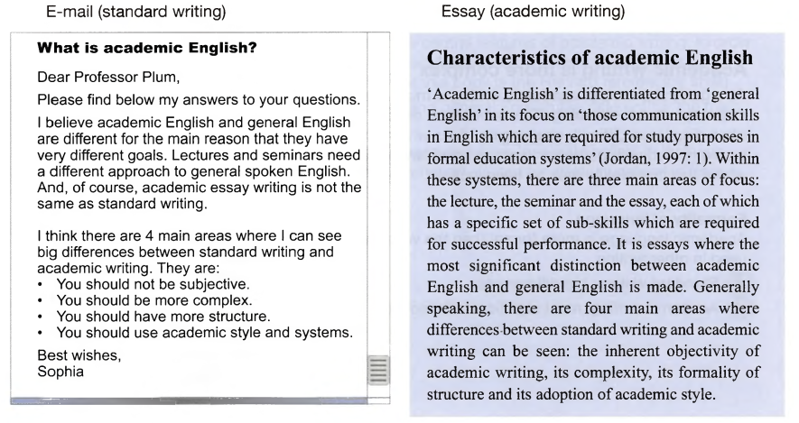

Slide 53
How to achieve key features of academic writing?
Strategy 1
Hedging language
Strategy 2
Empty introductory words
Strategy 3
Passive voice
Objectivity
Academics are not looking for what you think or believe - they want to see what you can show, demonstrate and prove through evidence.
Generally speaking¹, there are² four main areas where differences between standard writing and academic writing can be seen³

Slide 54
Objectivity, strategy 1
Hedging language
Hedging language {generally speaking) increases the ‘distance’ between the writer and the text, thereby creating more objectivity.

Slide 55
Objectivity, strategy 2
Strategy 2:
Empty introductory phrases (there are) provide a platform for objective statements.

Slide 56
Objectivity, strategy 3
The passive voice (can be seen) removes the need for a subject in the sentence.

Slide 57
Avoiding “I”
I will examine the evidence…
This report will examine…
The evidence will be examined..

Slide 58
Passive voice
The researcher collected samples at 8:00 am.
The samples were collected at 8:00 am.
Focus should be on what is done rather who has done it!

Slide 59
Should I avoid passive voice?
Jafari et al.(2015) analyzed the responses from 250 surveys and found that…
The responses from 250 surveys were analyzed, and it was found that ….(Jafari et al., 2015).
Active voice is appropriate when the focus and responsibility should be placed on the one who did an action.

Slide 60
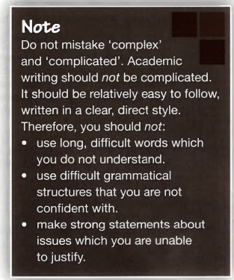
Academic writing is more complex
Academic writing often discusses difficult, challenging ideas which can only be expressed with particular grammar and language.

Slide 61
Areas of complexity (Formality of language)
Standard writing: big differences
Academic writing: most significant distinction

Slide 62
Areas of complexity (grammatical structure)
There are particular grammatical forms which appear more frequently in academic writing than other writing.
Passive voice
Noun phrases
Relative clauses

Slide 63
Areas of complexity (density of language)
The higher ‘density’ can be achieved through
A greater use of content words (such as verbs and nouns) rather than structure words (such as prepositions and conjunctions).

Slide 64
Academic writing is more formal
Introduction, main body, conclusion...
Cohesion and coherence
Fonts
….
Formal structure
Formal words

Slide 65
Word choice
✔️
Good | Quality
Big | Substantial
Thing | Idea
Get | obtain
Don’t | Do not
Can’t | Can not
And (start) | In addition, therefore…

Slide 66
Academic writing uses more referencing
In order to show where these ideas come from (and to avoid plagiarism)

